Slide 1
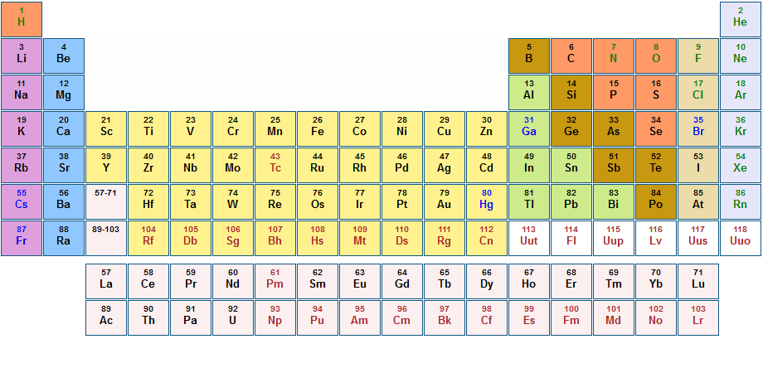
Interactive Periodic Table Quiz
Aswathy Dinesh

Slide 2
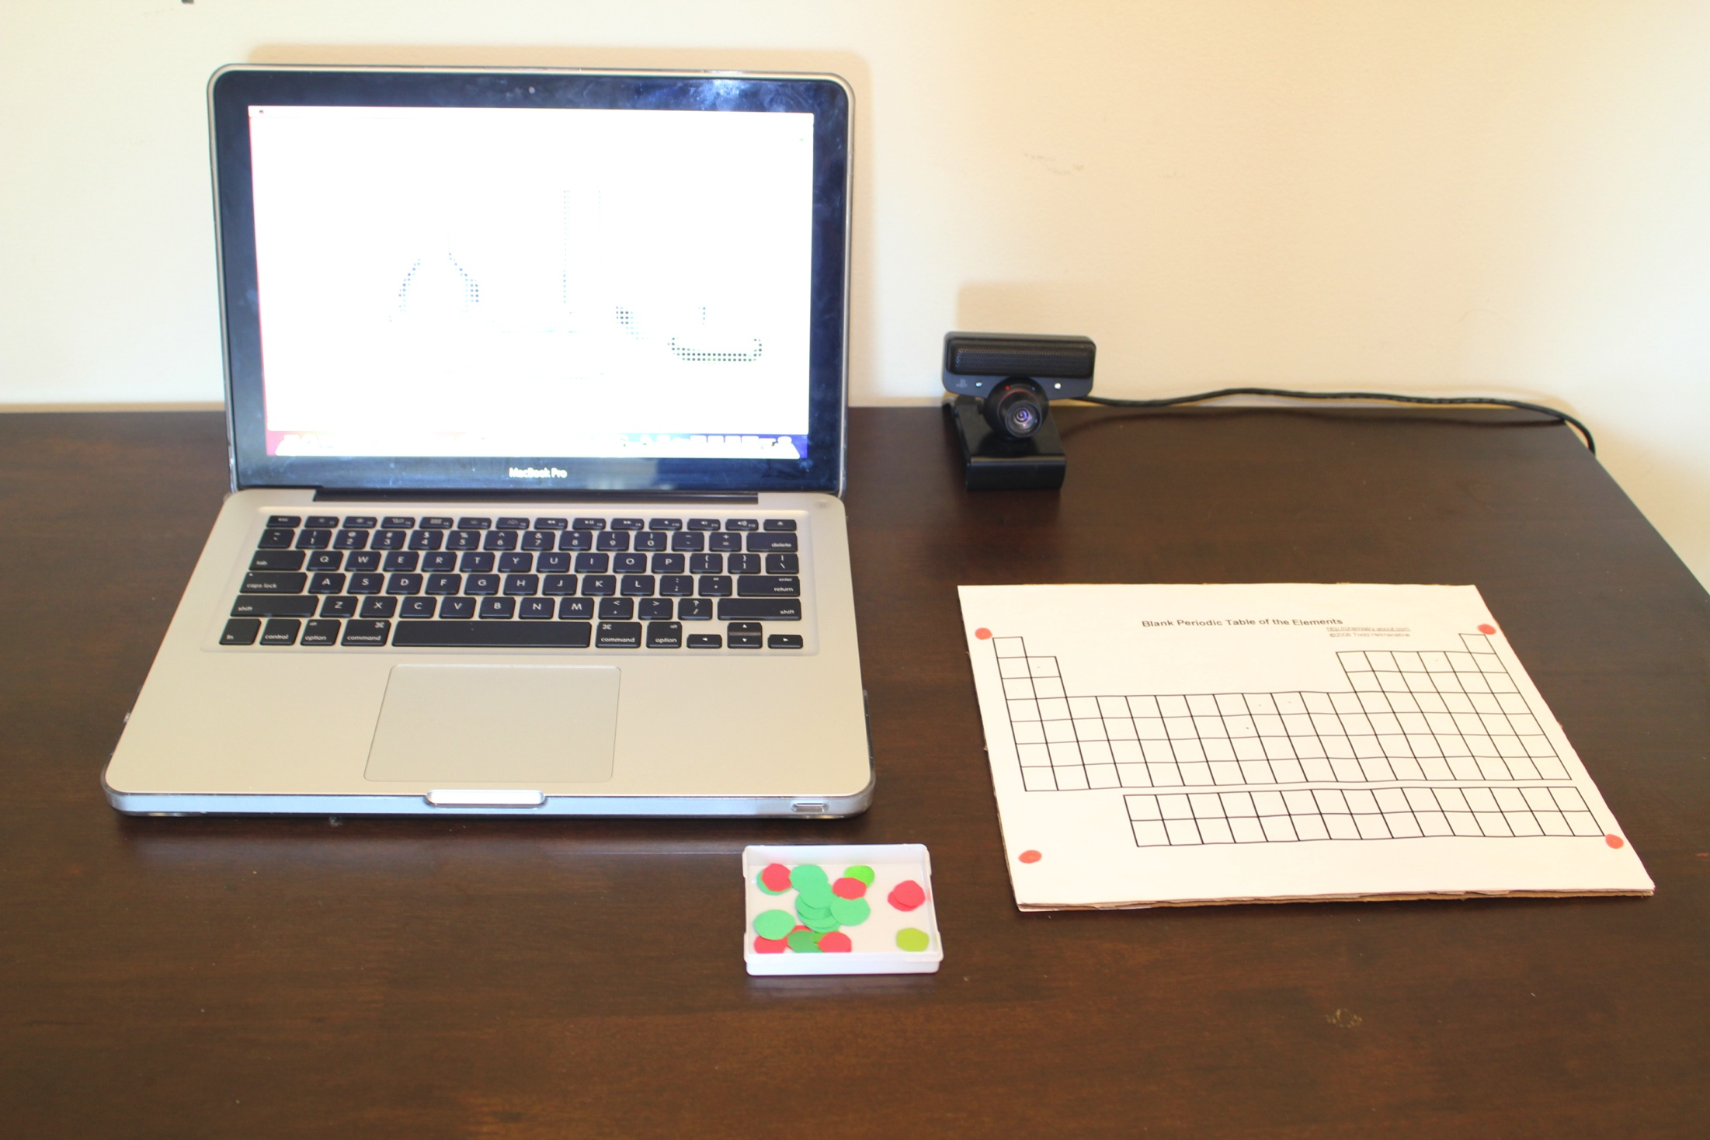
Camera
Blank periodic table
Marker

Slide 3
Introduction
This system is a chemistry game to find an elements position on an interactive periodic table
Programming Language used LabVIEW

Slide 4
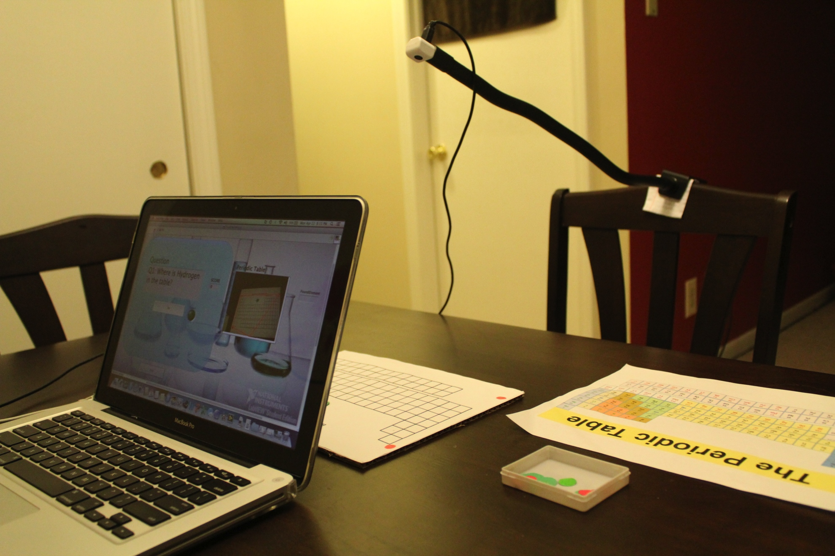
Experimental Setup
Video Camera
Blank Periodic Table
Green & Red Markers

Slide 5
How did I built this system?
Tracking the blank periodic table
Used four red markers to track corners of periodic table
Created a bounding box around these corners
Finding the element position
Used green marker to track element
Calculated distance of green marker to four corners
Creating a lookup table
Table with Element name and position based on four corners
Creating an Interface
To play the chemistry game

Slide 6
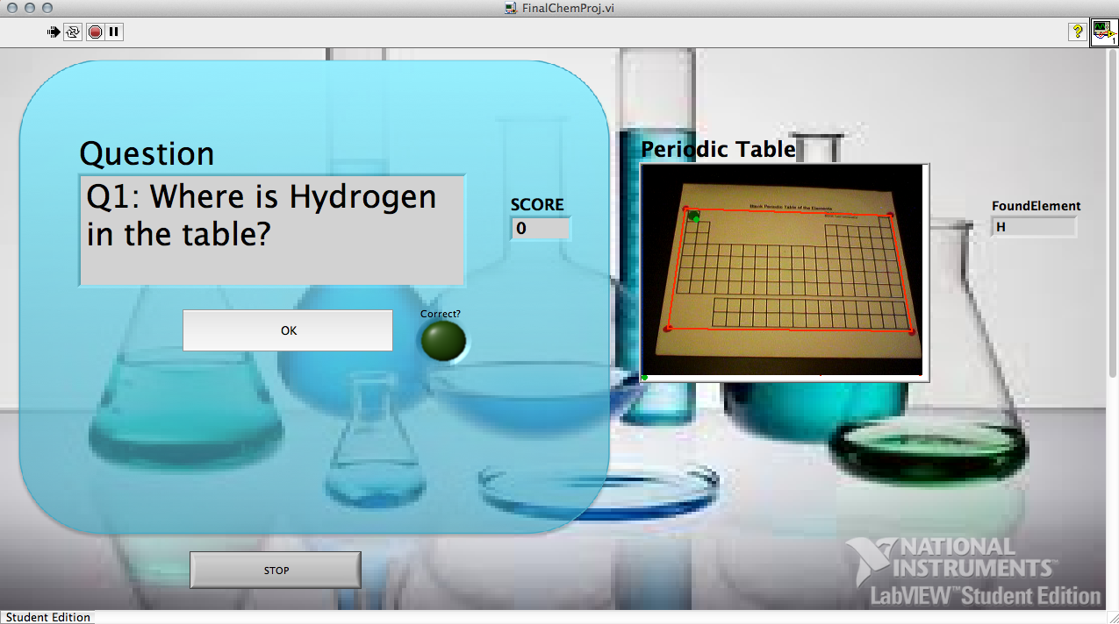
How does the system work?

Slide 8
A
T
B
a
b
Rb
Ra
L
(x,y)
R
G
Rd
d
c
Rc
D
C
B

Slide 9

Interactive Periodic Table Demo

Slide 10

Questions

